Slide 1
Automating your CI/CD Stack with Java and Groovy
Jeanne Boyarsky & Scott Selikoff
Tuesday Oct 23, 2018
Oracle Code One – HOL4957
Please begin installing Docker/Jenkins/Nexus NOW!
https://goo.gl/XesKPB

Slide 2
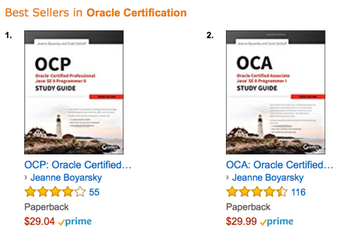
About Us
Combined
30+ years Java
15+ years tooling
10+ years Groovy
@jeanneboyarsky @scottselikoff

Slide 3
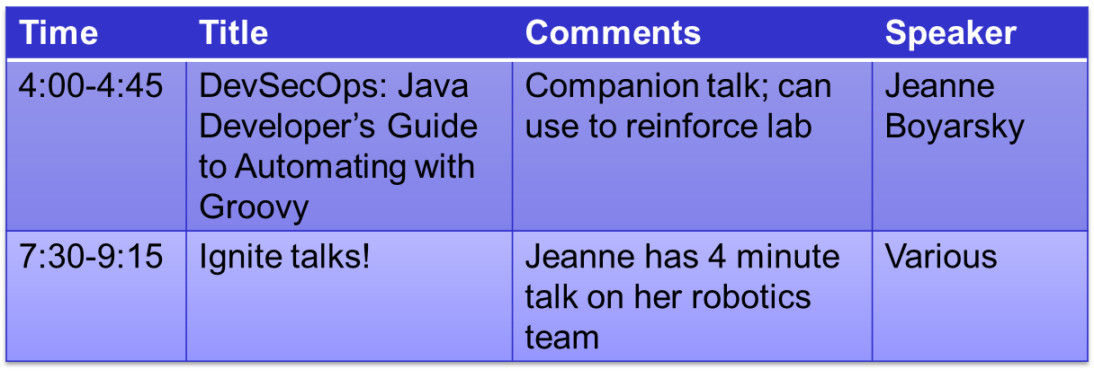
Tuesday More from Jeanne

Slide 4
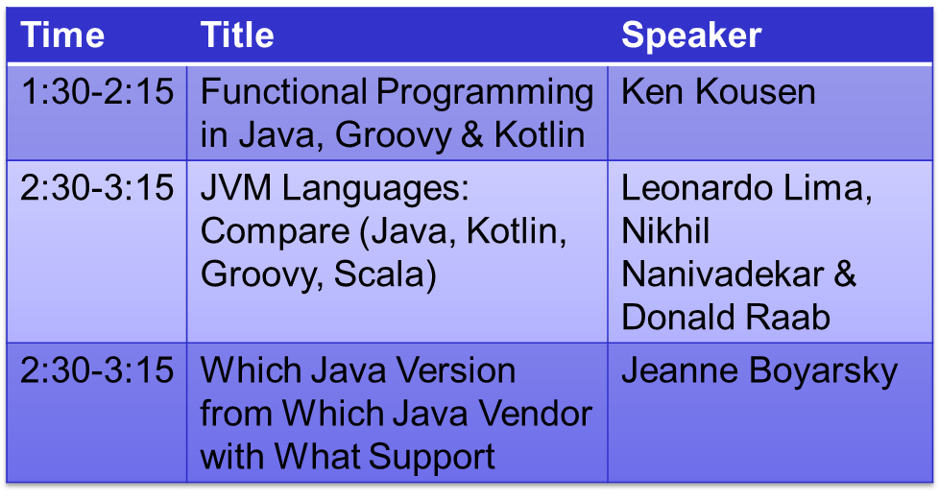
Wednesday Recommendations

Slide 5
What you’ll learn in the lab
Ways you can run Groovy in Nexus/Jenkins
Using object model APIs from Groovy
Configuring a custom Java Sonar rule
The initial steps in securing a system

Slide 6
Technologies used in this Lab
Docker
Jenkins
Nexus Repository Manager
SonarQube

Slide 7

Docker
Container-based Platform
Virtualized environment
  Mini “slice” of a virtual machine
Stored as images, run as containers
All tools for this lab run will run from Docker

Slide 8
Overview
HOL Network
Docker container
Docker container
Docker container
Nexus
Jenkins
Sonar
Binary repository
CI Engine
Static analysis

Slide 9
Docker
Stop
Run
Remove
Start

Slide 10

Jenkins
Management tool for continuous
integration and continuous delivery
  CI: Checking in code triggers builds
  CD: Builds are sent to various environments
Highly customizable with numerous scripting and automation options
Run as projects steps/pipelines

Slide 11

Nexus Repository Manager
Serves dependencies to Maven/Gradle
Store snapshot and release artifacts (builds)
Similar to Artifactory

Slide 12

SonarQube
Continuous Inspection of code quality
Exposes bugs and potential vulnerabilities using static code analysis
Focuses on the structure of code and enforcing rules across a project

Slide 13
Other tools/languages
Groovy – JVM programming language
curl – command line (we use to test network connectivity)

Slide 14
One minute intro to Groovy
For this lab
Use Java if you don’t know Groovy
All Groovy code in solution guide for reference (or copy/paste)
Don’t waste time on Groovy syntax if don’t already know Groovy.
More on Groovy syntax at 4pm
Groovy
Java

Slide 15
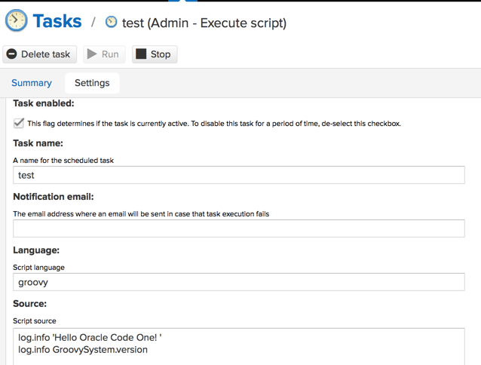
log.info'Hello Oracle Code One! ’
log.info GroovySystem.version

Slide 16
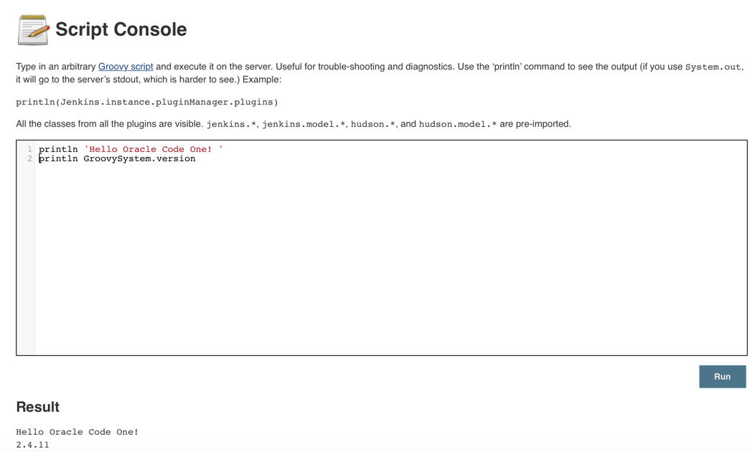
println 'Hello Oracle Code One! '
println GroovySystem.version
Hello Oracle Code One!
2.4.11

Slide 17
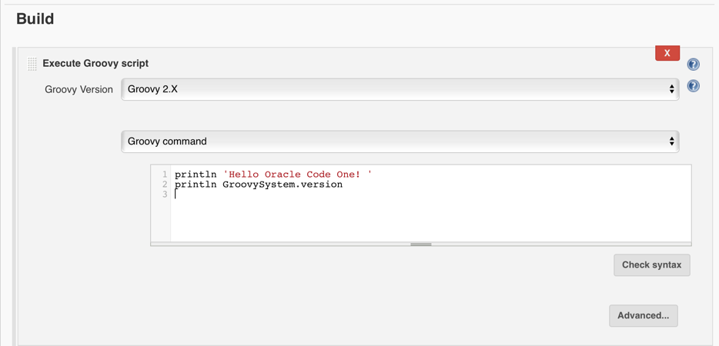

Slide 18
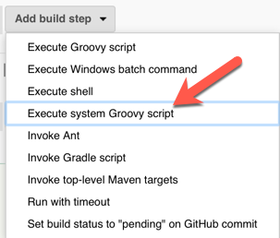
System scripts can access object model
Can’t choose
Groovy version

Slide 19
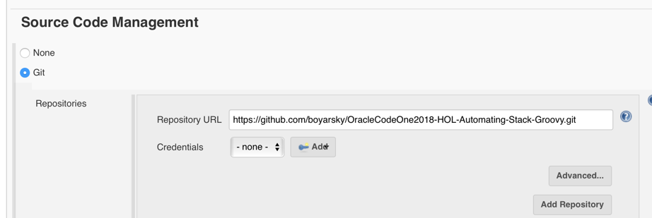
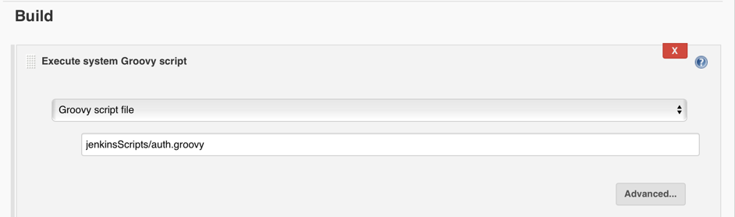

Slide 20
Script Security Plugin
ERROR: Build step failed with exception
org.jenkinsci.plugins.scriptsecurity.sandbox.RejectedAccessException: Scripts not permitted to use staticMethod jenkins.model.Jenkins getInstance
Options:
Approve each script manually
Sandbox - whitelist APIs
Authorized Build plugin to run as admin
Copy/paste Groovy code (we do this in the lab)

Slide 21
Flow
The lab is self paced
Raise your hand if you get stuck or have a question.
If there is a FAQ, we will demo it on the screen.

Slide 22

Let’s start!
On to the lab!
In a browser go to
https://goo.gl/Gc3uyy
Notes:
https://pixabay.com/p-154544/?no_redirect

